Slide 1
Jenkins: A CI/CD Tool for DevOps

Slide 2
Contents
Continuous Integration using DevOps Tools
Jenkins
Jenkins Installation
Setup plugins and Create jobs in Jenkins
Integrating Jenkins with GitHub, Junit
Create Deploy job
Create Complete Pipeline
CI / CD Build Pipeline

Slide 3
Continuous Integration
Continuous integration (CI) is the practice of automating the integration of code changes from multiple contributors into a single software project. It’s a primary DevOps best practice, allowing developers to frequently merge code changes into a central repository where builds and tests then run. Automated tools are used to assert the new code’s correctness before integration.

Slide 4
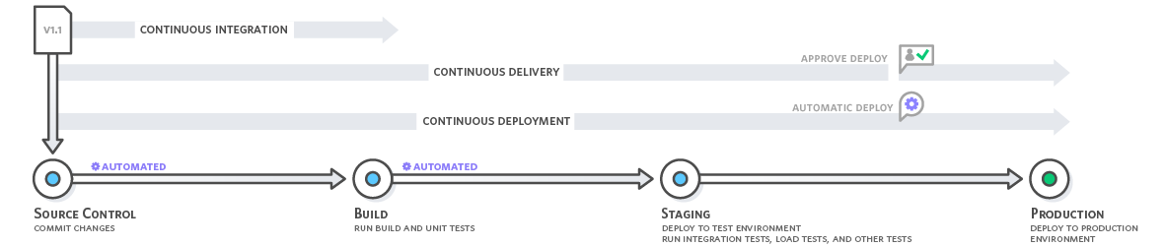
How does Continuous Integration Work?
Testing

Slide 5

s
Jenkins - is an open source automation tool written in Java programming language that allows continuous integration.
It provides hundreds of plugins to support building, deploying and automating any project.
It is to automate all sorts of tasks related to building, testing, and delivering or deploying software.
Jenkins can be installed through native system packages, Docker, or even run standalone by any machine with a Java Runtime Environment (JRE) installed.

Slide 6
Jenkins Advantages
It is an open source tool.
It is free of cost.
It does not require additional installations or components. Means it is easy to install.
Easily configurable.
It supports 1000 or more plugins to ease your work. If a plugin does not exist, you can write the script for it and share with community.

Slide 7
Jenkins Advantages (Cont.)
It is built in java and hence it is portable.
It is platform independent. It is available for all platforms and different operating systems. Like OS X, Windows or Linux.
Easy support, since it open source and widely used.
Jenkins also supports cloud based architecture so that we can deploy Jenkins in cloud based platforms.

Slide 8
Jenkins Disadvantages
Its interface is out dated and not user friendly compared to current user interface trends.
Not easy to maintain it because it runs on a server and requires some skills as server administrator to monitor its activity.
CI regularly breaks due to some small setting changes. CI will be paused and therefore requires some developer's team attention.

Slide 9
Installing Jenkins on Windows
Hardware Requirements
Software Requirements
Memory | 2 GB RAM (Recommended)
Disk Space | We need at least 1 GB of space in our hard drive for Jenkins
JDK | We need either Java Development (JDK) or Java Runtime Environment (JRE)
Operating System | Jenkins can be installed on Windows, Mac OS X
Java Container | The WAR (Web Application Resource) file can be run in any container that supports Servlet 2.4/JSP 2.0 or later. (For example Tomcat 5).

Slide 10
Jenkins Release Types
Long term support release (LTS): Long-term support releases (LTS) are available every 12 weeks. They are stable and are widely used and tested. Basically, this release is intended for end users.
Weekly release: This release is available in every week by fixing bugs in its earlier version. These releases are intended towards plugin developers.

Slide 11
Java Setup for Jenkins
Java Setup
Install Java JDK
https://www.oracle.com/java/technologies/javase/jdk17-archive-downloads.html
Configure the environment variables
User Variable
System Variables (bin)
Once the java has been installed properly on your system and Java environment variable has been set, then you can verify it by using the following commands:
C:\ echo %JAVA_HOME%
C:\ javac -version
C:\ java -version

Slide 12
Jenkins Setup
Download Jenkins Installer
https://www.jenkins.io/download/
https://get.jenkins.io/war-stable/2.332.3/jenkins.war
Run the setup to install Jenkins. Associate a port number to it while installation. Default port number is 8080
Now, open the browser and go the link
http://localhost:8080

Slide 13
Setup plugins and create jobs in Jenkins
Create jobs in Jenkins
GitHub - Code, Plug-in (Git and Github Plugin), Poll SCM
Junit - Test, Plug-in (Junit)
Deploy – Deploy

Slide 14
Setup plugins and create jobs in Jenkins (Cont.)
In the Home screen of the Jenkins (Jenkins Dashboard) click on the Manage Jenkins option on the left hand side of the screen.

Slide 15
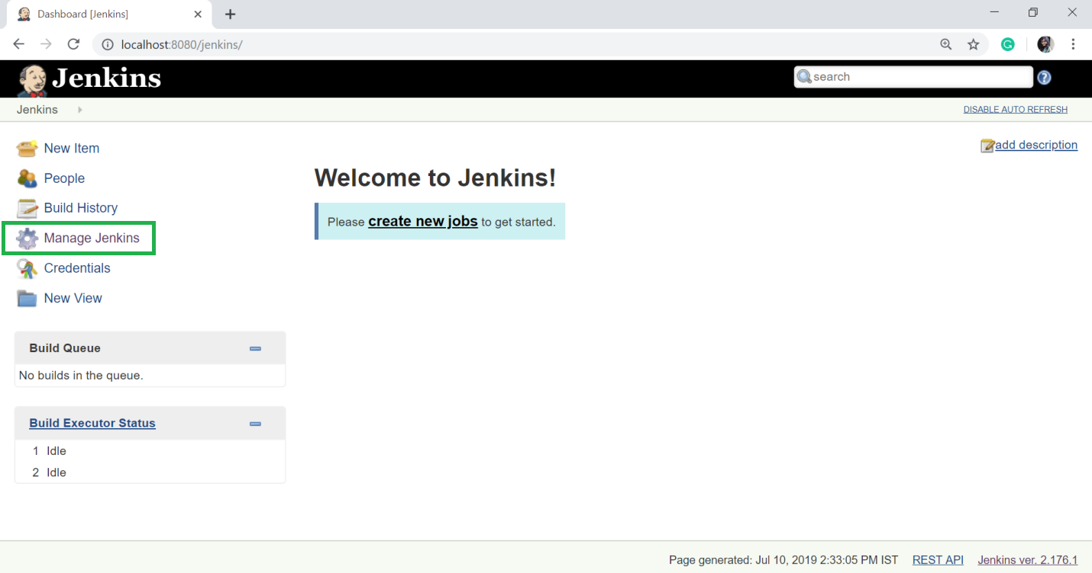
Setup plugins and Create jobs in Jenkins (Cont.)

Slide 16
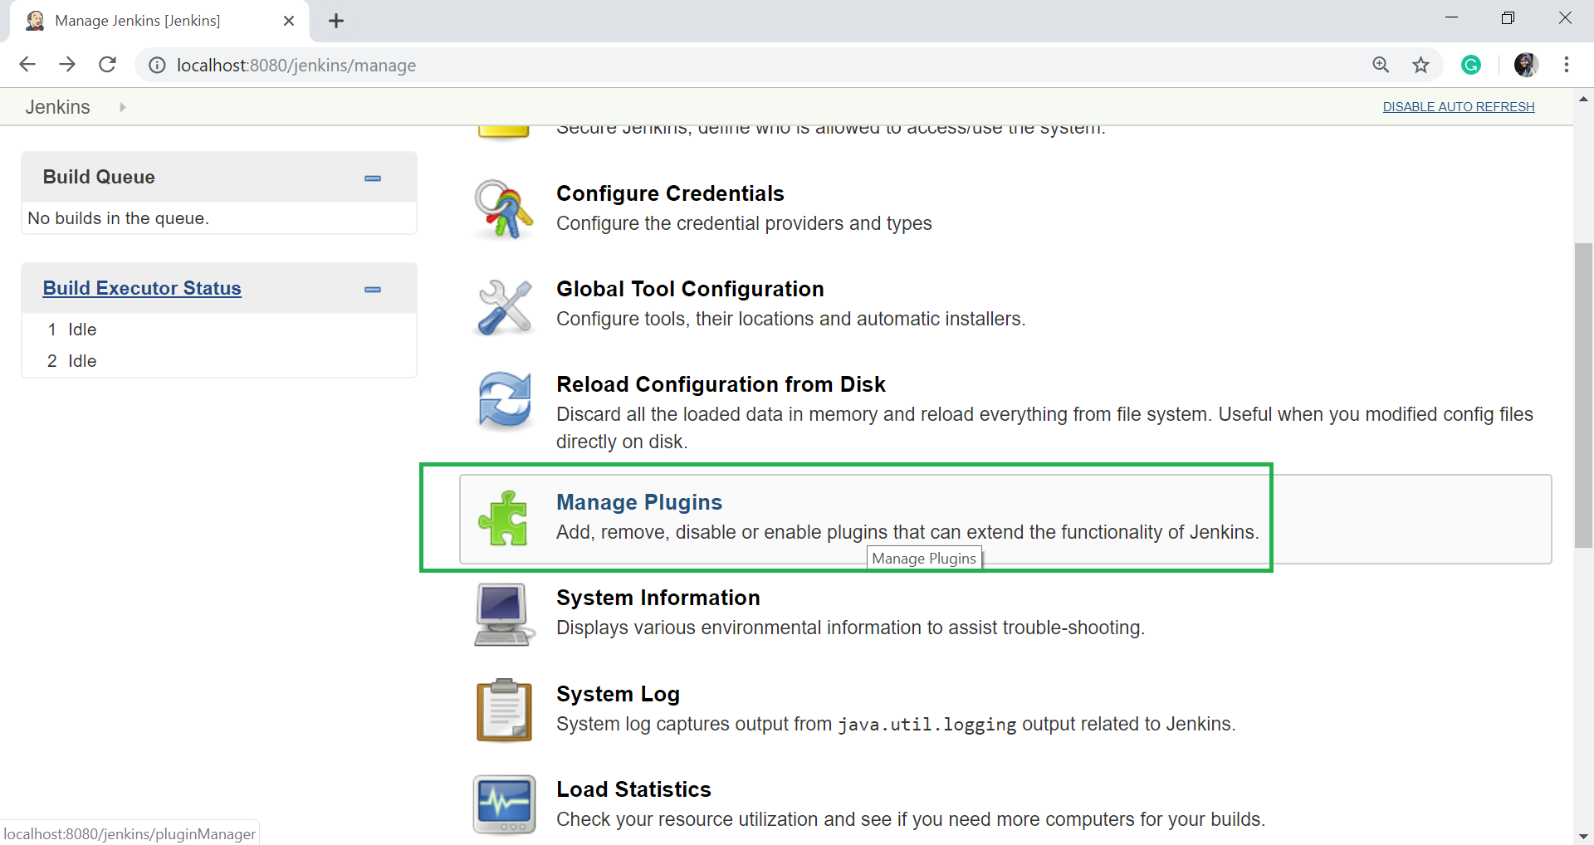
Setup plugins and Create jobs in Jenkins (Cont.)
Now, click on the Manage Plugins option.

Slide 17
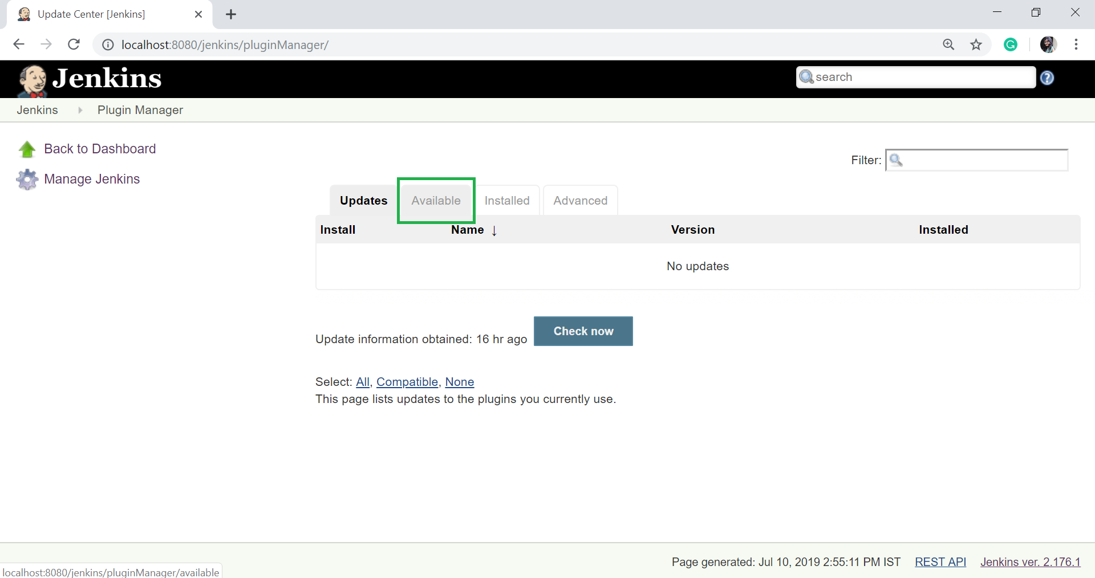
Setup plugins and Create jobs in Jenkins (Cont.)
In the next page, click on the "Available tab“

Slide 18
Setup plugins and Create jobs in Jenkins (Cont.)
The "Available" tab gives a list of plugins which are available for downloading. In the Filter tab type, type the "Git Plugin".
Select the GitHub and Git Plugin.
Click on the "install without restart". The plugin will take some time to finish downloading depending on your internet connection, and will be installed automatically.
You can also click on "Download now and install after restart" button in which the git plugin is installed after restart.
If you already have the Git plugin installed then go to "Installed" tab and in filter option type Git plugin.

Slide 19
Integrating Jenkins with GitHub
If you don't have Git installed in your system. To install the Git in your system, download the appropriate Git setup according to your operating system. I am installing for windows. Once the download is completed, install the Git.
Create directory in C:/> “gitworkspace”
Clone desired code repository from github.
https://github.com/xxxxx/xxxx.git

Slide 20
Integrating Jenkins with GitHub (Cont.)
Now Create GitHub Job
Let's see the process of integrating GitHub into Jenkins in a windows system.
First create a new job in Jenkins, open the Jenkins Dashboard and click on "create new jobs".
Click on “New Item”

Slide 21
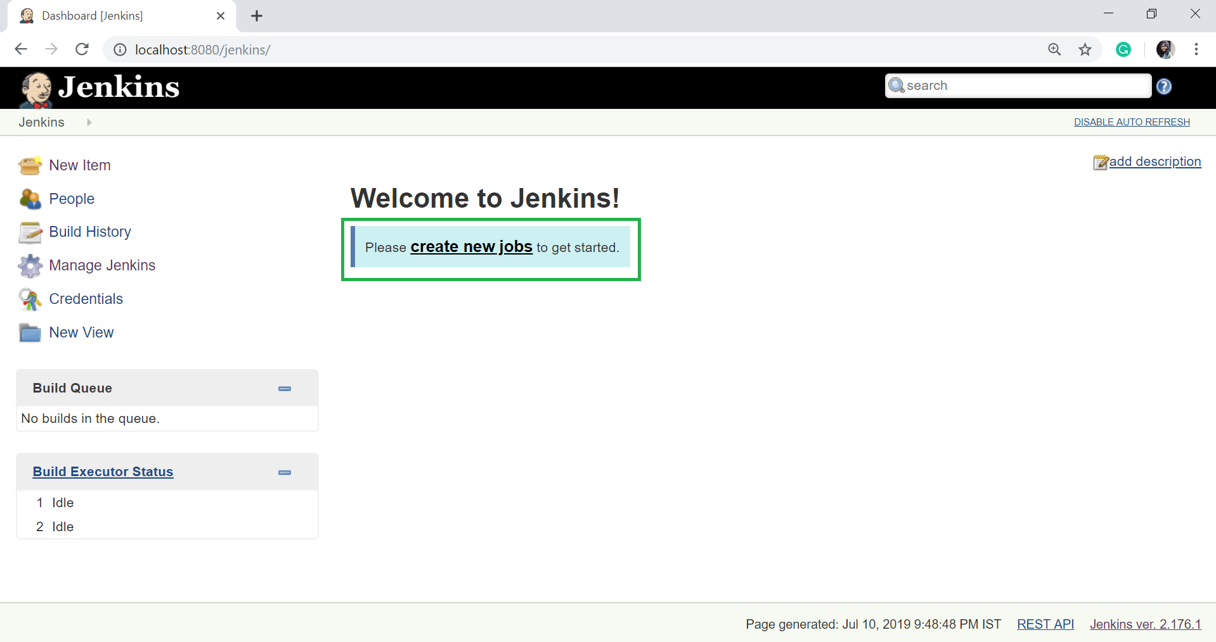
Integrating Jenkins with GitHub (Cont.)

Slide 22
Integrating Jenkins with GitHub (Cont.)
Now enter the item name and select the job type. For example, item name is ”githubpull” and job type is "Freestyle project".
Click on OK.
Once you click OK, the page will be redirected to its project configuration. Enter the project information.

Slide 23
Integrating Jenkins with GitHub (Cont.)
Now, under the "Source Code Management" you will see the Git option, if your Git plugin has been installed in Jenkins:
Enter the Git repository URL on the "Repository URL" option to pull the code from GitHub.
https://github.com/xxxxxx/xxxxx.git
Now Click on Apply and Save job

Slide 24
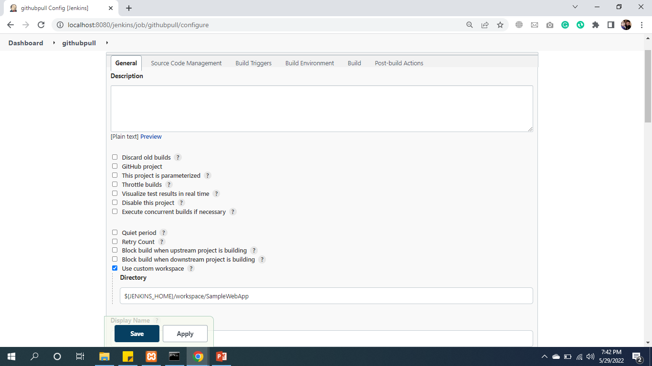
Integrating Jenkins with GitHub (Cont.)

Slide 25
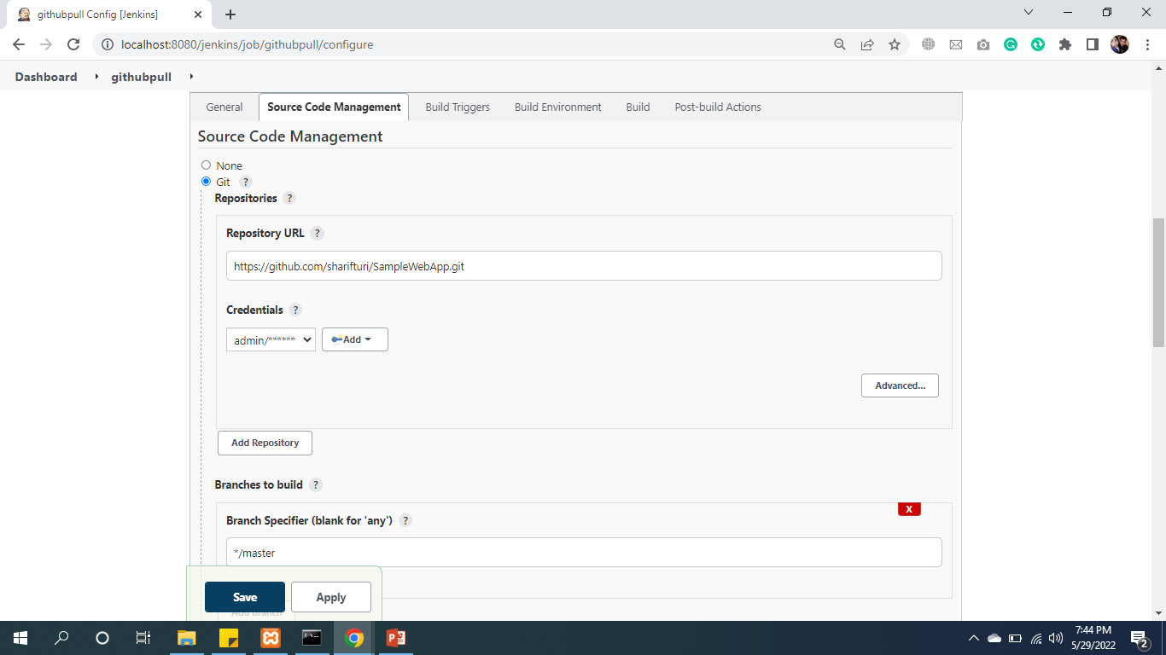
Integrating Jenkins with GitHub (Cont.)

Slide 26
Build Tool Ant
Apache Ant - (Another Neat Tool) is an open source project started by Apache Software Foundation and initially released on 19 July 2000.
Ant is a Java library and a software tool used for automate software build processes such as compile, run, test and assemble Java application.
It is a better alternate of Make build tool of Unix. Ant is written in Java and require JVM to build the Java projects.

Slide 27
Integrating Jenkins with Ant
Apache Ant - (Another Neat Tool) is an open source project started
Download archive: apache-ant-1.9.16-bin.zip
https://ant.apache.org/bindownload.cgi
Create apache-ant-1.9.16 directory in C:/apache-ant-1.9.16 copy downloaded ant .zip file and extract it.
Set environment variables System Variables path of (C:\apache-ant-1.9.16\bin)

Slide 28
Create Build Job buildandcodereview Using Ant Tool (Cont.)
Now, click on the Manage Plugins option.

Slide 29
Create Build Job buildandcodereview Using Ant Tool (Cont.)
In the next page, click on the "Available tab“ search “Ant” and ”Warning Next Generation”

Slide 30
Create Build Job buildandcodereview Using Ant Tool

Slide 31
Install “Ant” and ”Warning Next Generation” Plugins

Slide 32
Create Build Job Ant Tool (Cont.)
The "Available" tab gives a list of plugins which are available for downloading. In the Filter tab type, type the " Ant and Warning Next Generation Plugin".
Select the “Ant” and ”Warning Next Generation” Plugin one by one.
Click on the "install without restart". The plugin will take some time to finish downloading depending on your internet connection, and will be installed automatically.
You can also click on "Download now and install after restart" button in which the “Ant” and ”Warning Next Generation” plugin is installed after
Now restart Tomcat and Jenkins.

Slide 33
Create unittest Job
After Testing required plugins installation
Create Unittest job

Slide 34
Unite-Test Tool (Junit)
JUnit is a unit testing framework for Java programming language.
It plays a crucial role test-driven development, and is a family of unit testing frameworks collectively known as xUnit.
JUnit promotes the idea of "first testing then coding", which emphasizes on setting up the test data for a piece of code that can be tested first and then implemented.

Slide 35
Install “Junit” Plugin

Slide 36
Install “Junit” Plugin (Cont.)
Now, click on the Manage Plugins option.

Slide 37
Install “Junit” Plugin (Cont.)
Search Junit Real-time Reporter Plugin

Slide 38
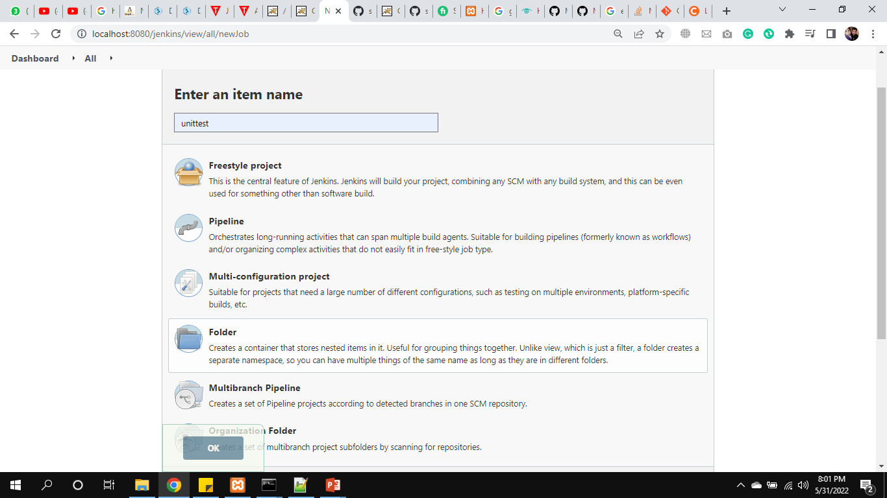
Create Job unittest Using JUnit Tool

Slide 39
Configure unittest

Slide 40
Configure unittest (Cont.)

Slide 41
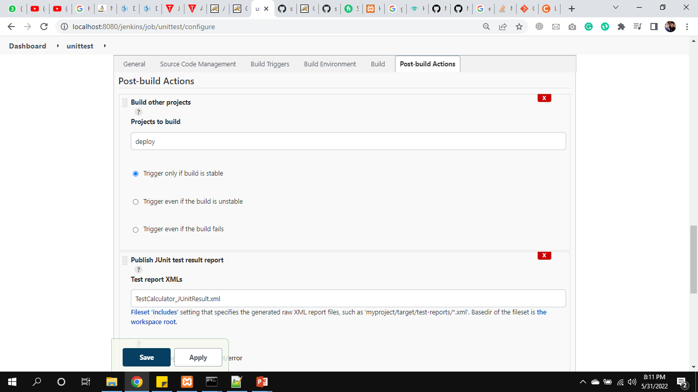
Configure unittest Post-Build-Action
Select and Set Publish JUnit test result report

Slide 42
Create Deploy job and Install Required Plugins
Deploy code to production
Install Deploy to Container plugin
Create new Job Deploy

Slide 43
Configure Deploy Job
Set Advance and git Description
${JENKINS_HOME}/workspace/SampleWebApp
https://github.com/sharifturi/SampleWebApp.git
In Build to Invoke Ant set war
Post Build Action
select Deploy war/ear to a container
Type **/**war and samplewebapp
In container ( select tomcat version) set Credentials

Slide 44
CI / CD Build Pipeline
In a Jenkins Pipeline, every job has some sort of dependency on at least one or more jobs or events.
A Jenkins Pipeline is a collection of jobs or events that brings the software from version control into the hands of the end users by using automation tools. It is used to incorporate continuous delivery in our software development workflow.
Code
Build
Test
Deploy on Sever / Container
1
2
3
4

Slide 45
Create complete pipeline
Install Build Pipeline Plugin
After it, to Configure all jobs
In Post-build Actions
githubpull
Set build other projects
Check on Poll SCM: if any changes or update the code the start auto.
Set 5 (*****) to run pipeline after each one mints
Set trigger schedule
Set buildandcodereview to start automatic

Slide 46
Create complete pipeline (Cont.)
Buildandcodereview
Set build other projects
Set unittest to start automatic
Unittest:
Set build other projects
Set deploy to start automatic

Slide 47
Create complete pipeline (Cont.)
After configuration of all jobs create New view.
Click on (+) sign
Type name of view complete pipeline
Select Build Pipeline View
Click on Create

Slide 48
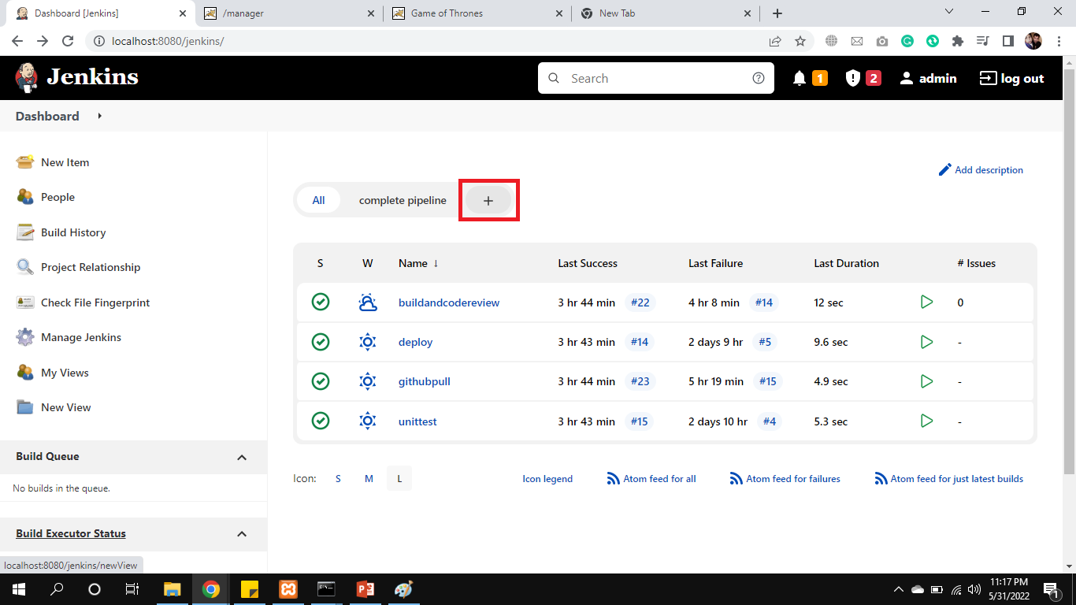
Create New view

Slide 49
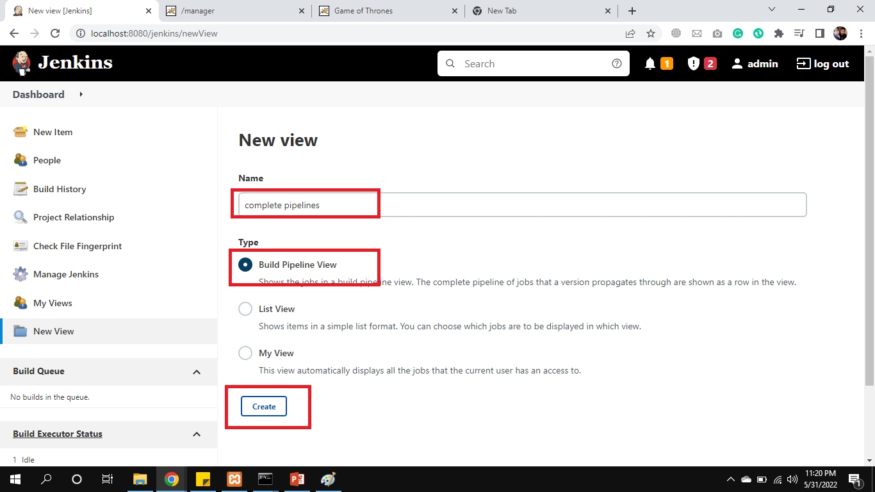
Create New view (Cont.)

Slide 50
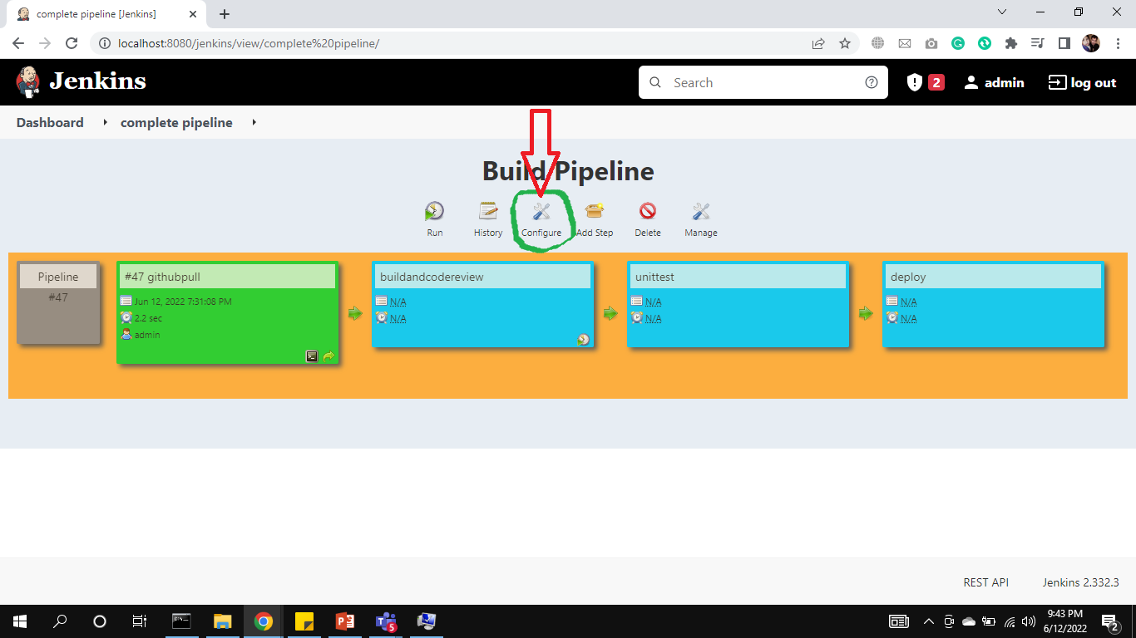
Build Pipeline Configuration
Click on Configure as mentioned in screenshot

Slide 51
Config Upstream / downstream
Select githubpull in Upstream / downstream config.
Click Ok

Slide 52
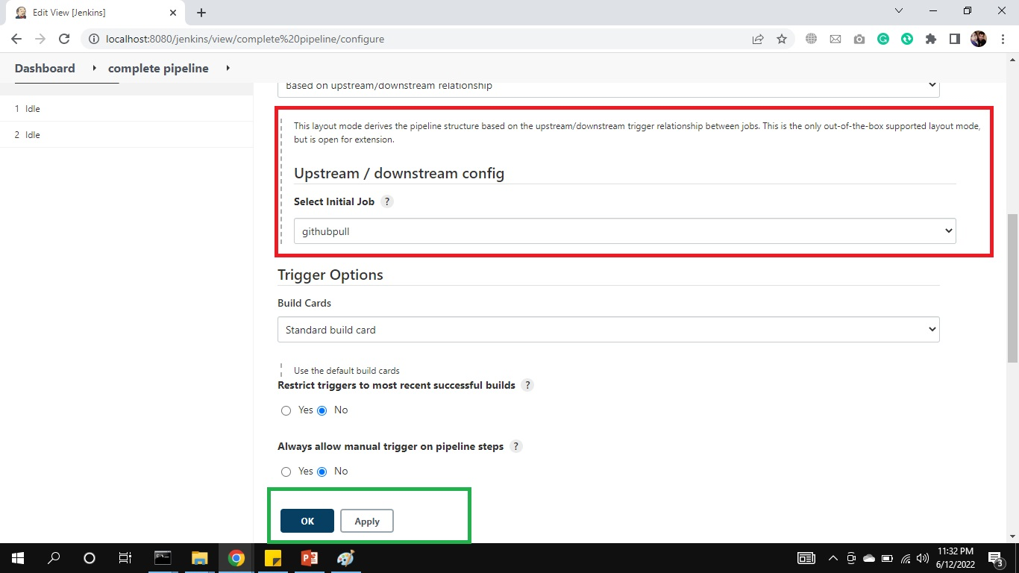
Create New view (Cont.)

Slide 53
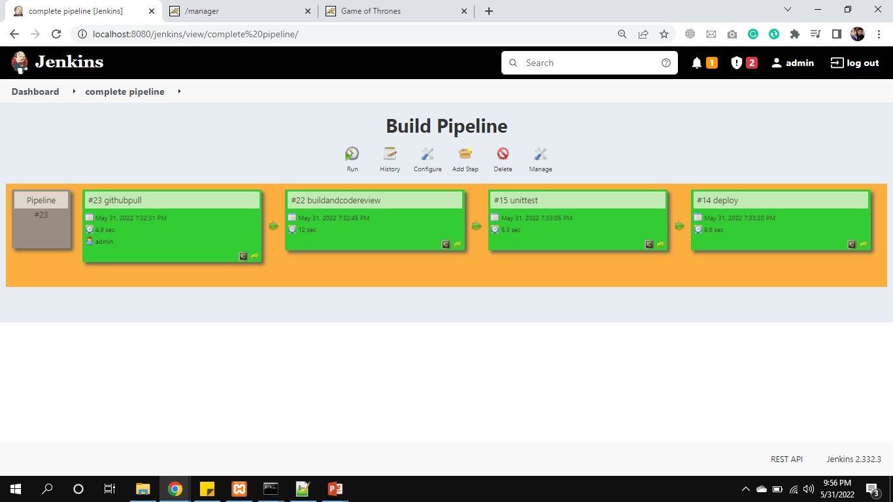
CI / CD Build Pipeline (Cont.)

Slide 54
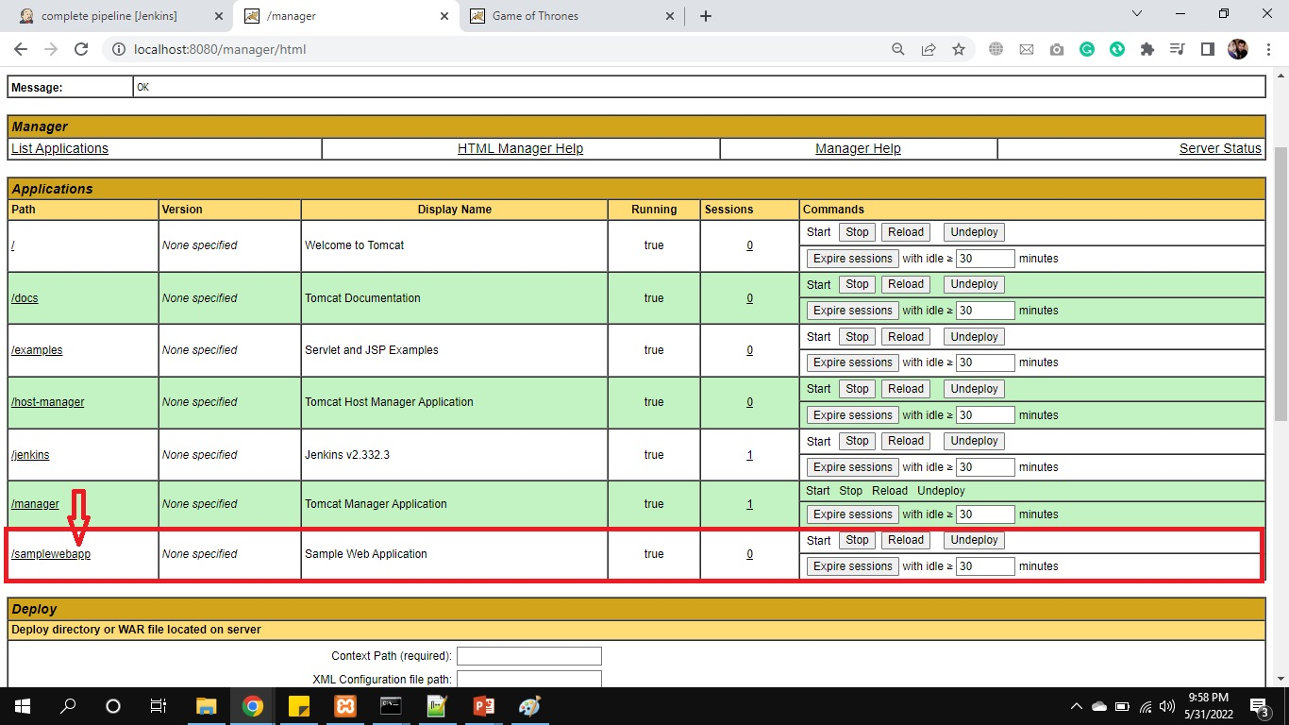
CI / CD Build Pipeline (Cont.)
Finally our application deployed on Tomcat Server.

Slide 55
Thanks
…?

